Slide 1
Bathroom Tissue Sales
Nicholas Larson
Robert Smith

Slide 2

The Data
Sales of Scott bathroom tissue at a grocery retailer
Values are daily sales
There are 400 days of sales history

Slide 3

Goal – Model the sales
How much does the store need to have in stock in order to meet demand?
?

Slide 4
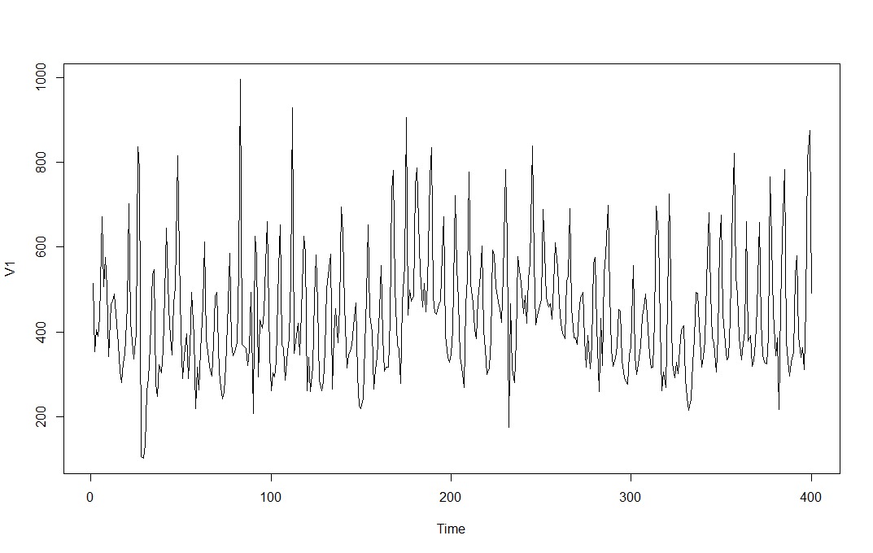
Plot of the data

Slide 5
Stationarity
ADF Test: p-val = 0.01
Conclude: Stationary
PP Test: p-val = 0.01
Conclude: Stationary
KPSS Test: p-val = 0.1
Conclude: Cannot reject that data is stationary

Slide 6
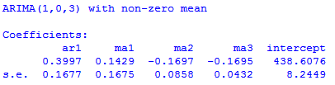
ARIMA(1,0,3)
Auto ARIMA function gives:
θ₁ is not significant

Slide 7
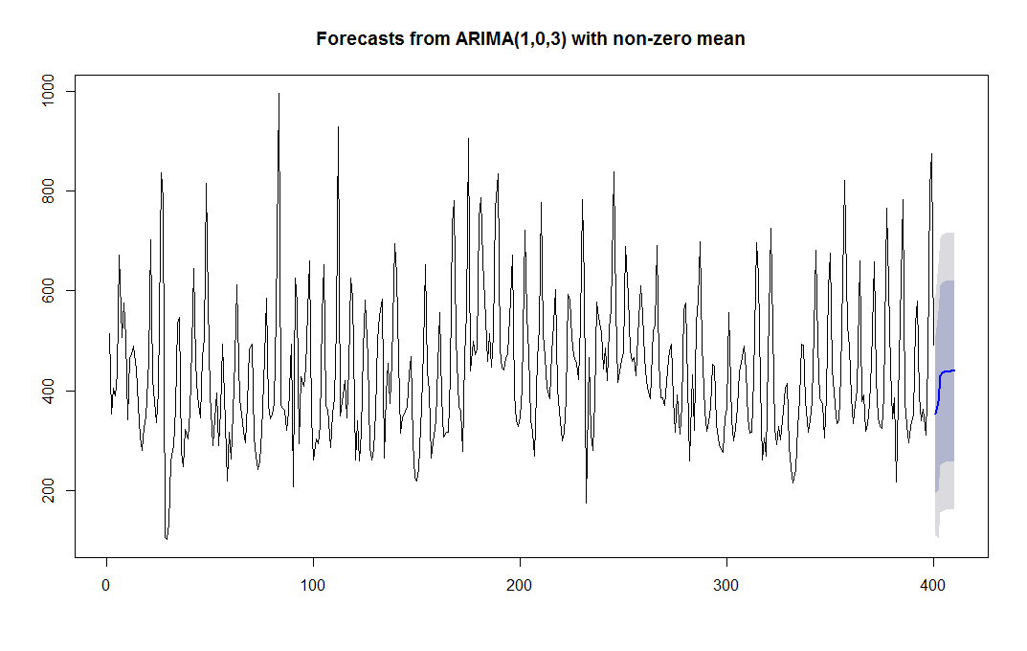
Forecast for ARIMA(1,0,3)

Slide 8
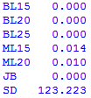
ARIMA(1,0,3)
Fails the Box-Ljung Test and McLeod-Li Test
The residuals are not independent!

Slide 9
Is a seasonal model better?
The data is daily sales
There is probably weekly seasonality because days of the week are related
i.e. Sundays have consistently higher sales

Slide 10
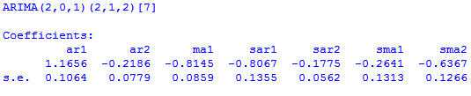
ARIMA(2,0,1)(2,1,2)[7]
All the coefficients are significant

Slide 11
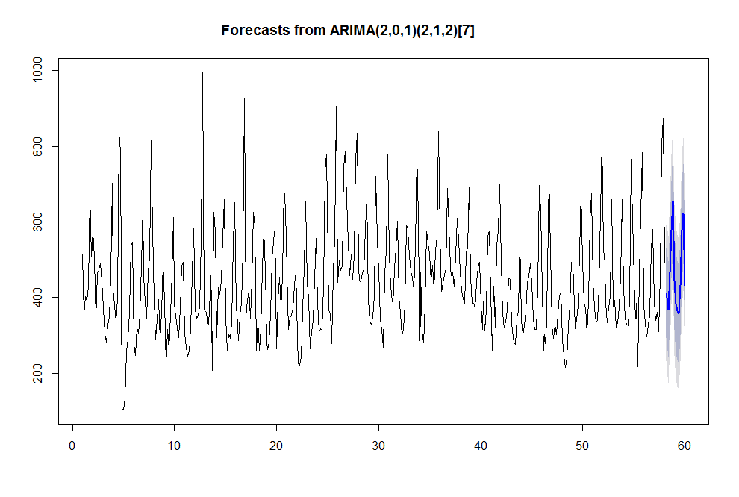
Forecast for ARIMA(2,0,1)(2,1,2)[7]

Slide 12

ARIMA(2,0,1)(2,1,2)[7]
The Box-Ljung test leads us to believe the residuals are independent
The McLeod-Li test does not agree!

Slide 13
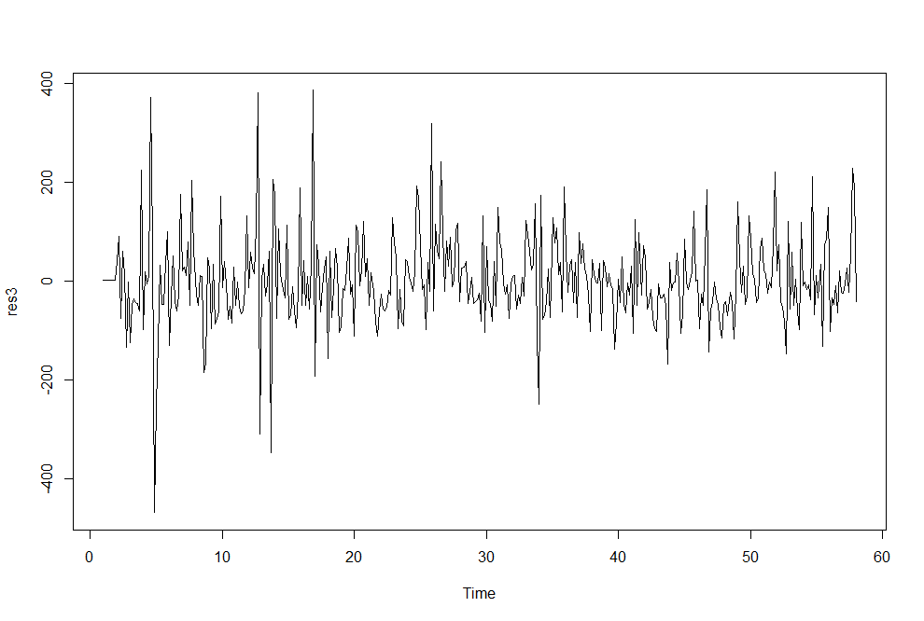
Residuals of ARIMA(2,0,1)(2,1,2)[7]

Slide 14
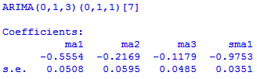
ARIMA(0,1,3)(0,1,1)[7]
After log transformation:
All coefficients are significant.

Slide 15
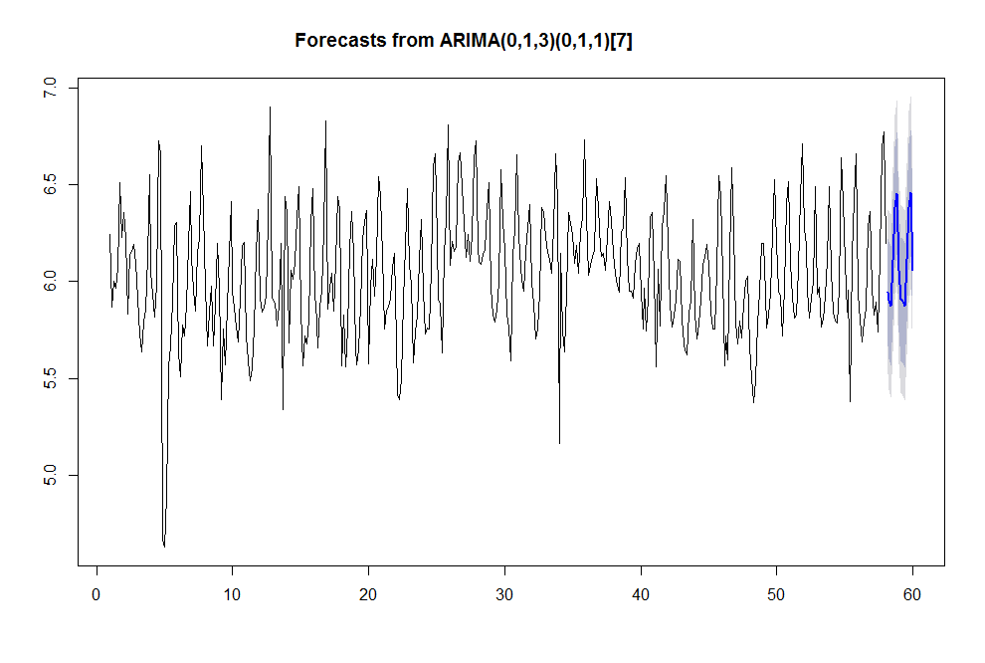
Forecast for ARIMA(0,1,3)(0,1,1)[7]

Slide 16

ARIMA(0,1,3)(0,1,1)[7]
The Box-Ljung test leads us to believe the residuals are independent
The McLeod-Li test does not agree!

Slide 17
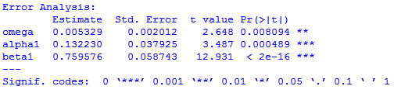
GARCH(1,1)

Slide 18

GARCH(1,1)
The Box-Ljung and McLeod-Li test both suggest that the residuals are independent.

Slide 19
Thank you!

